Slide 1
Downloading Dbeaver
Please do this before workshop

Slide 2


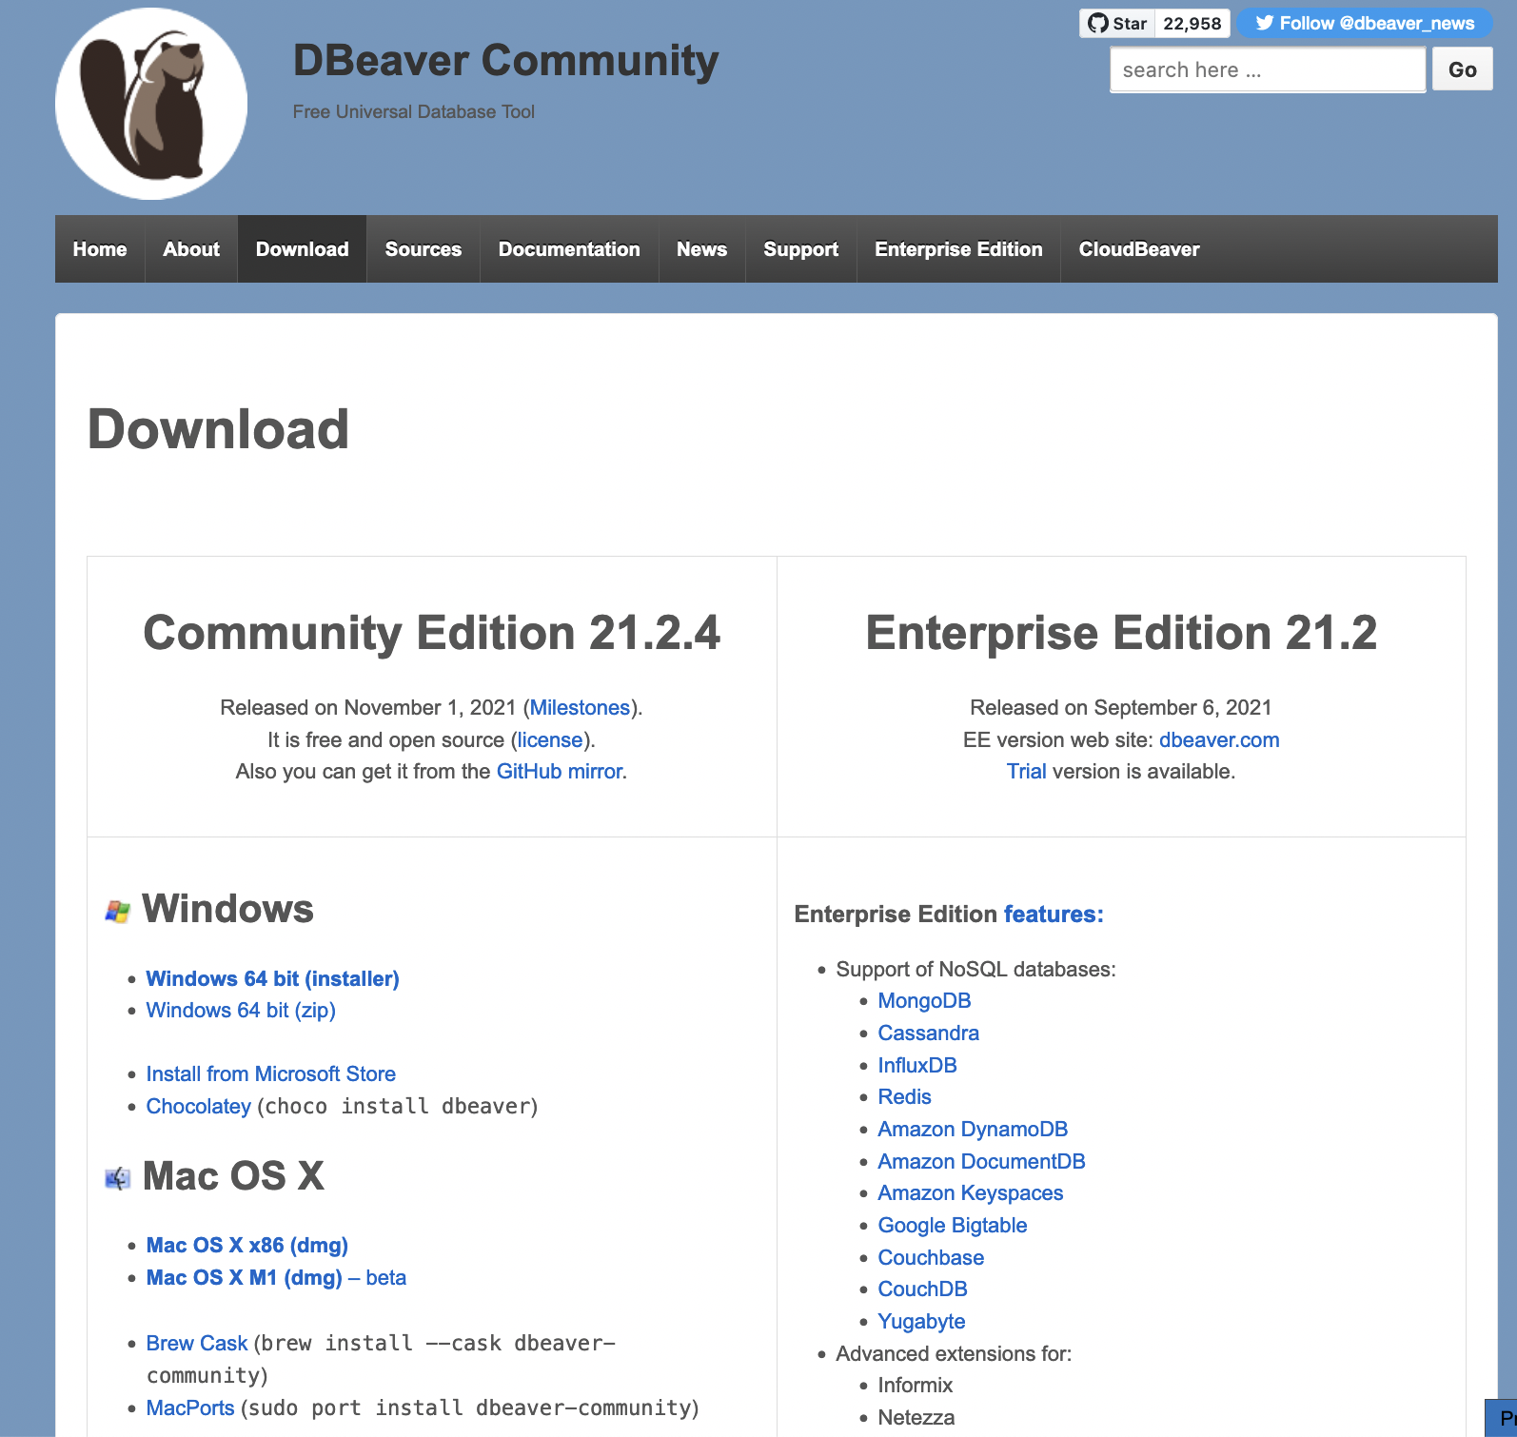
Steps to download
Website: https://dbeaver.io/download/
Navigate to downloads
Click on: Mac OS X x86 (dmg)

Slide 3
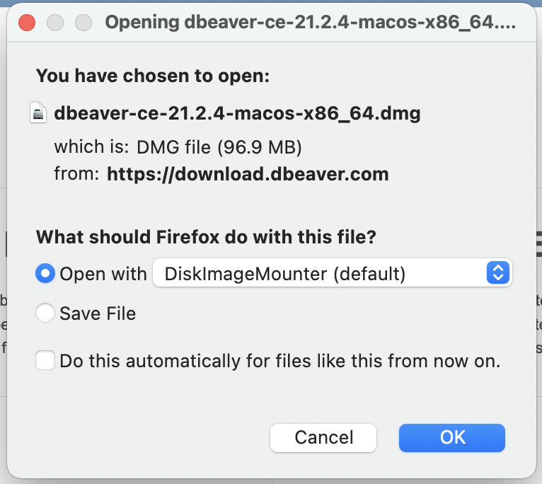
Steps to download (cont.)
Click on open with
Click OK

Slide 4
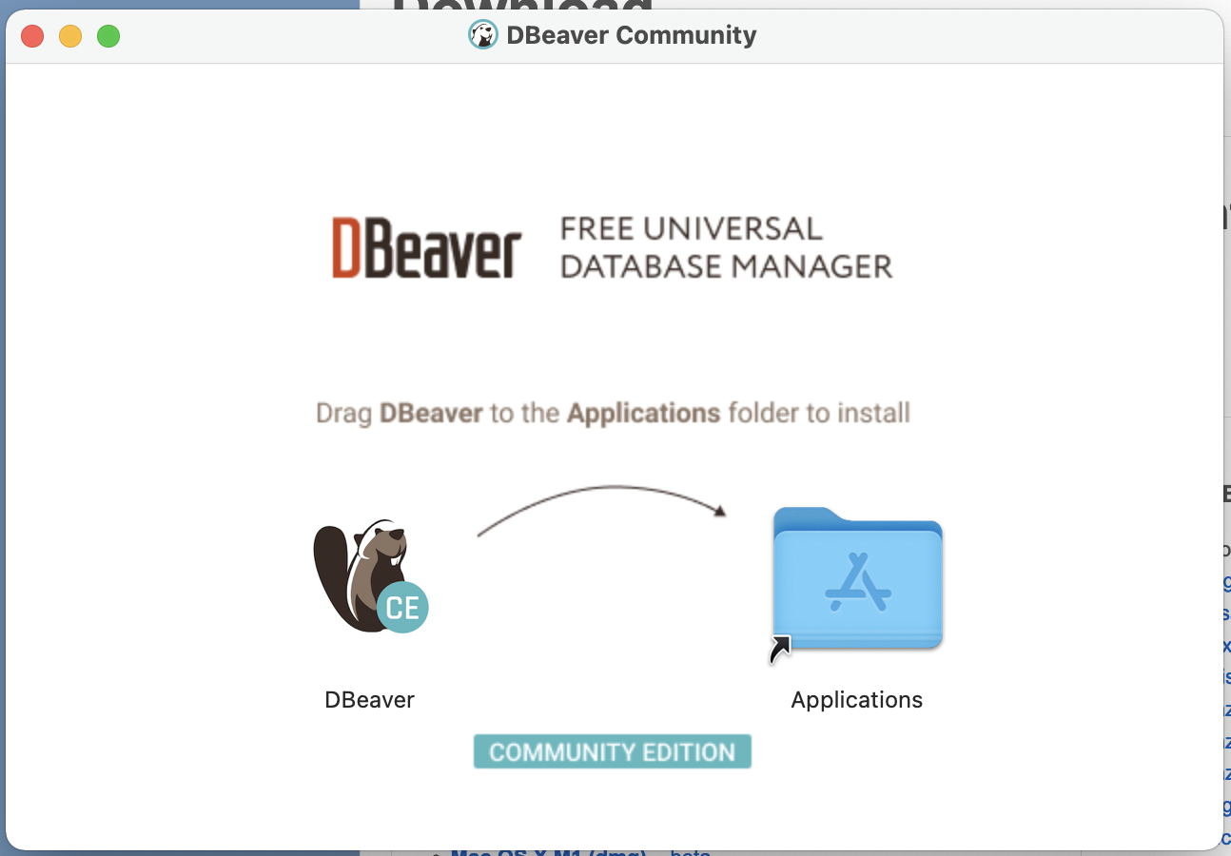
Steps to download (cont.)
Slide program over to applications

Slide 5
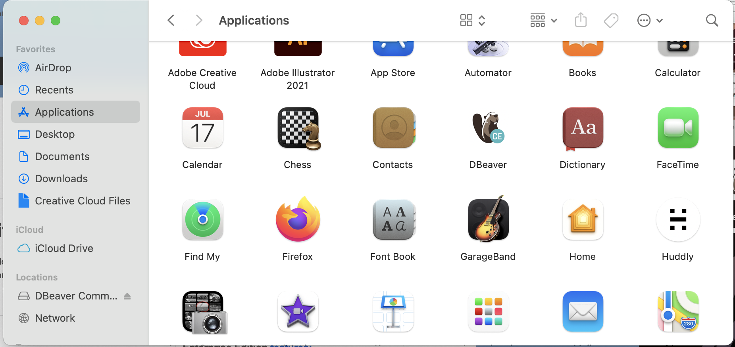
Steps to download (cont.)
You should find it in your applications, under the letter D.

Slide 6
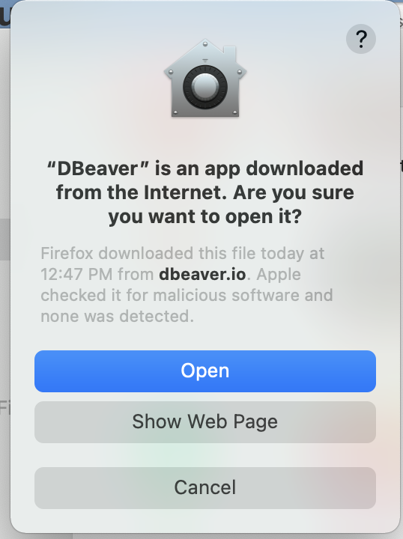
Steps to download (cont.)
First time opening it will ask this question, click open.

Slide 7
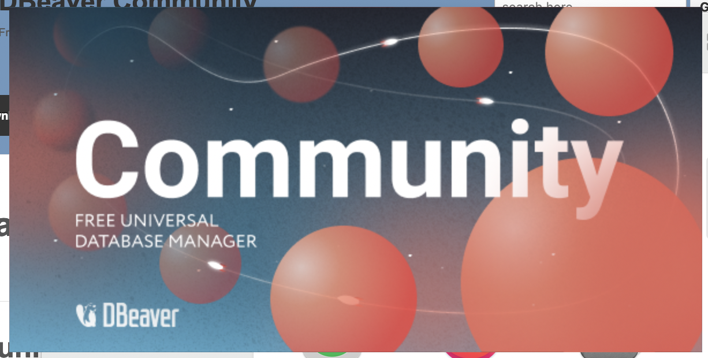
Steps to download (cont.)
This is what it should look like when you’re opening the application.

Slide 8
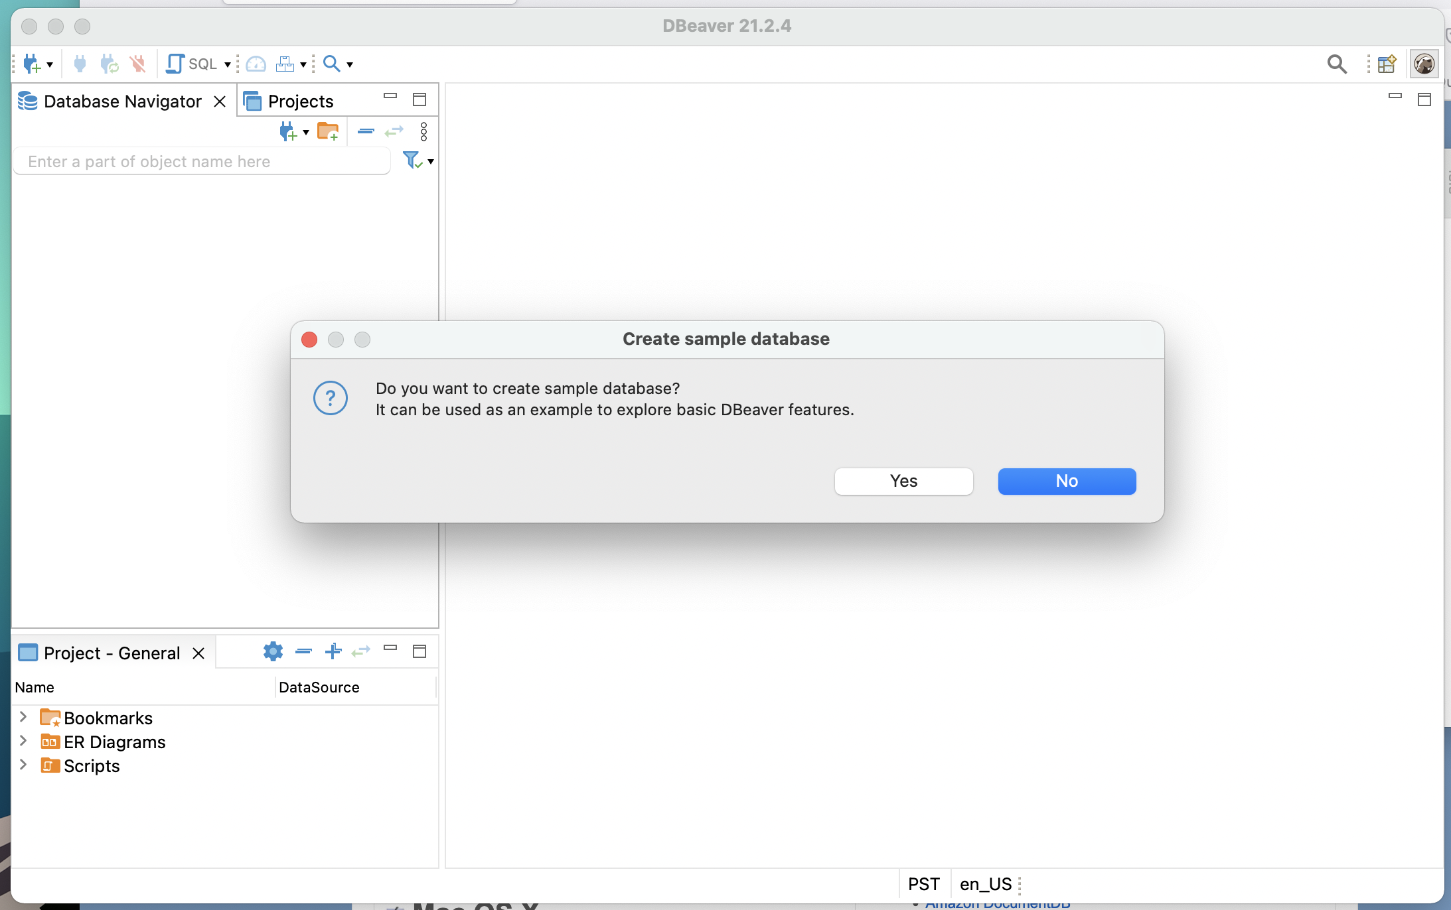
Steps to download (cont.)
First time opening it will ask if you would like to create a simple database, click yes. This is what we will be working with throughout the workshop. The SQL language will be SQL Lite.

Slide 9
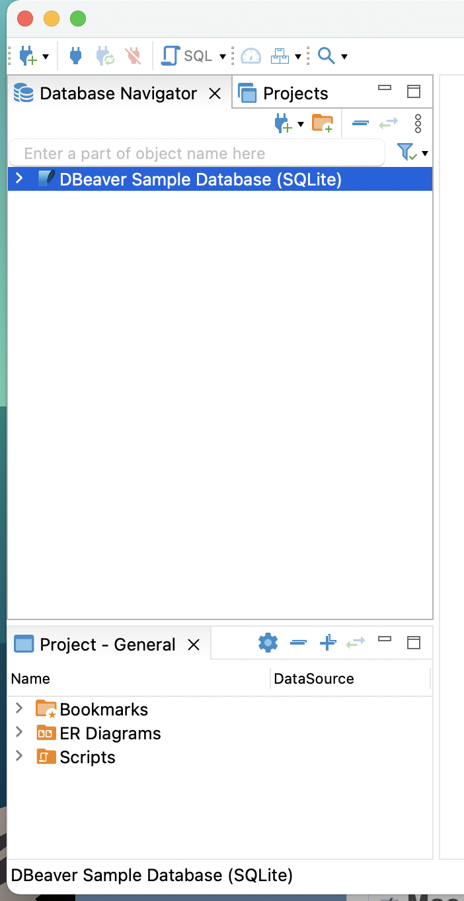
Steps to download (cont.)
This is what it should look like on your left-hand side of your program.

Slide 10
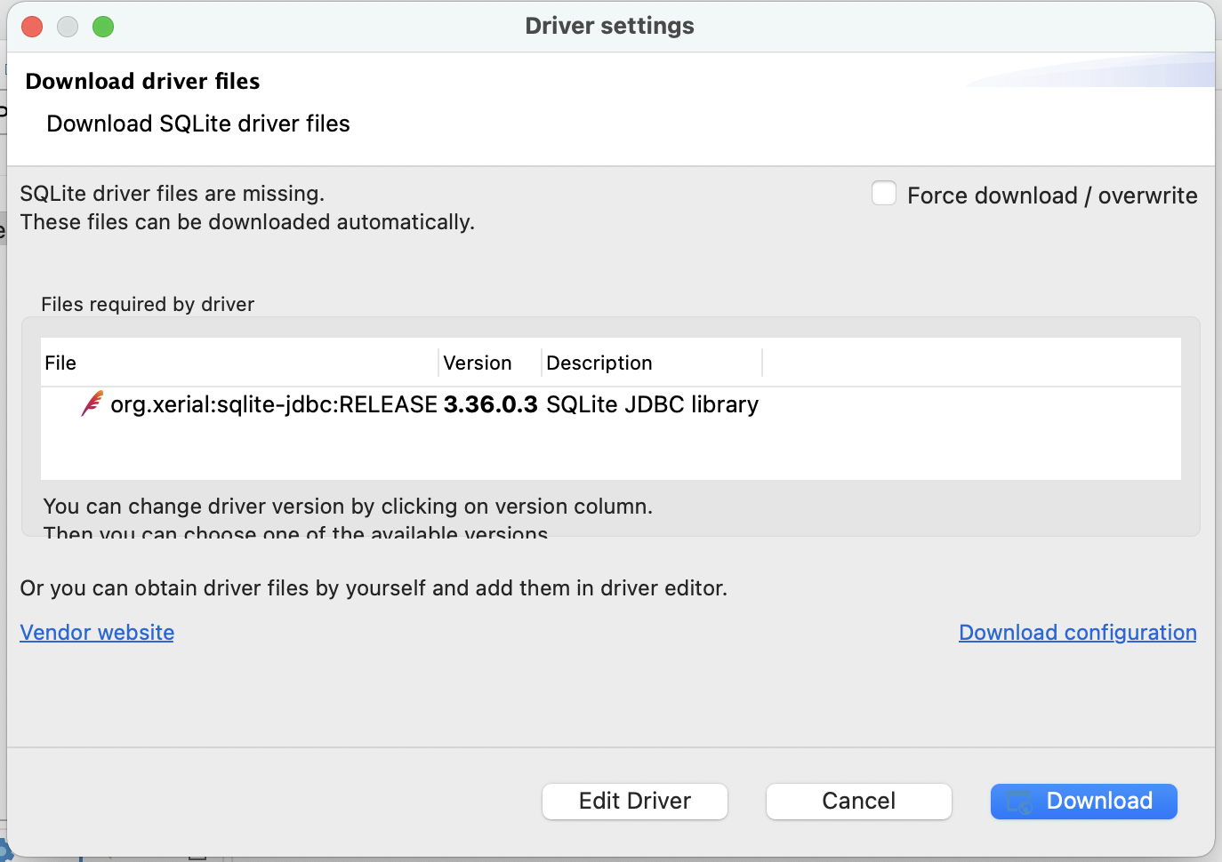
Steps to download (cont.)
When you first click on the database, this window will pop out click download.

Slide 11
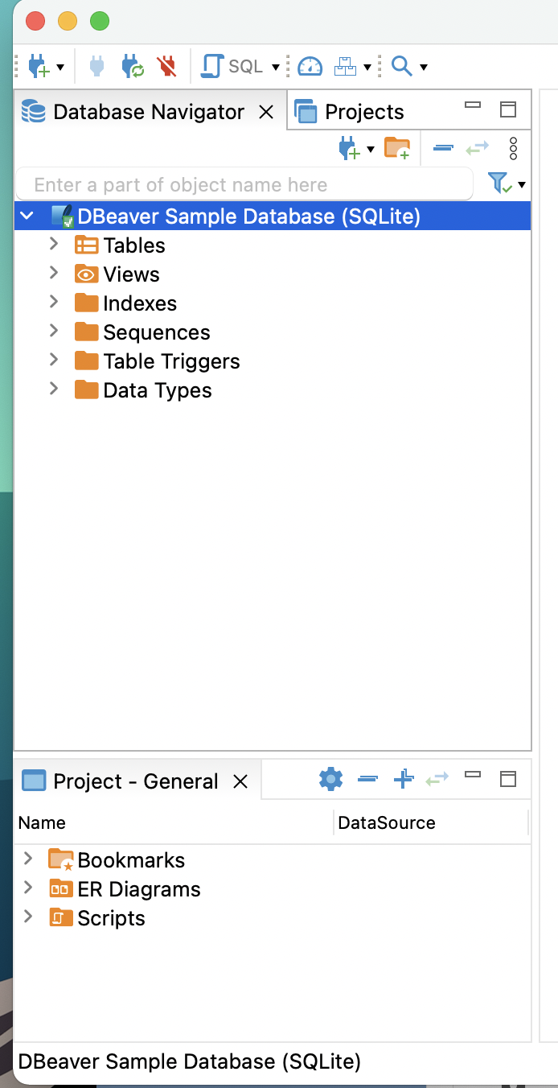
Steps to download (cont.)
Once it has finished downloading all of the drivers your left-hand side of the program should look like this.

Slide 12
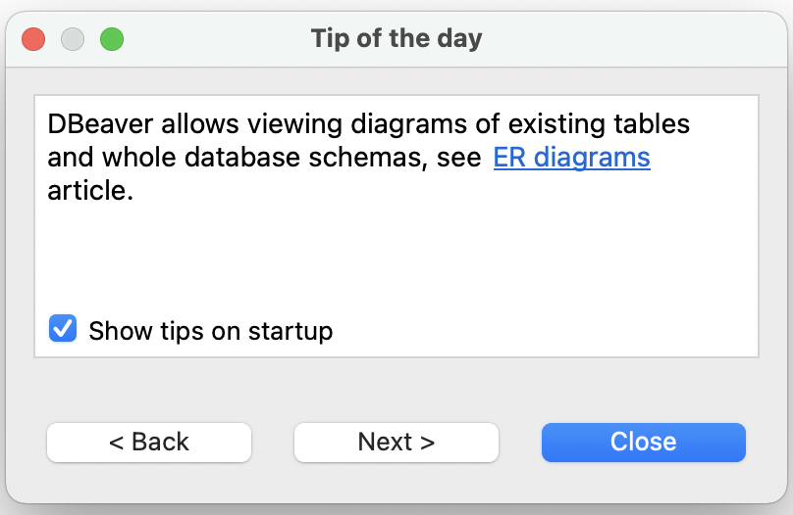
Steps to download (cont.)
When you open the program again usually this pops up, it’s just the tip of the day you can disable it by unclicking show tips on startup.

Slide 13
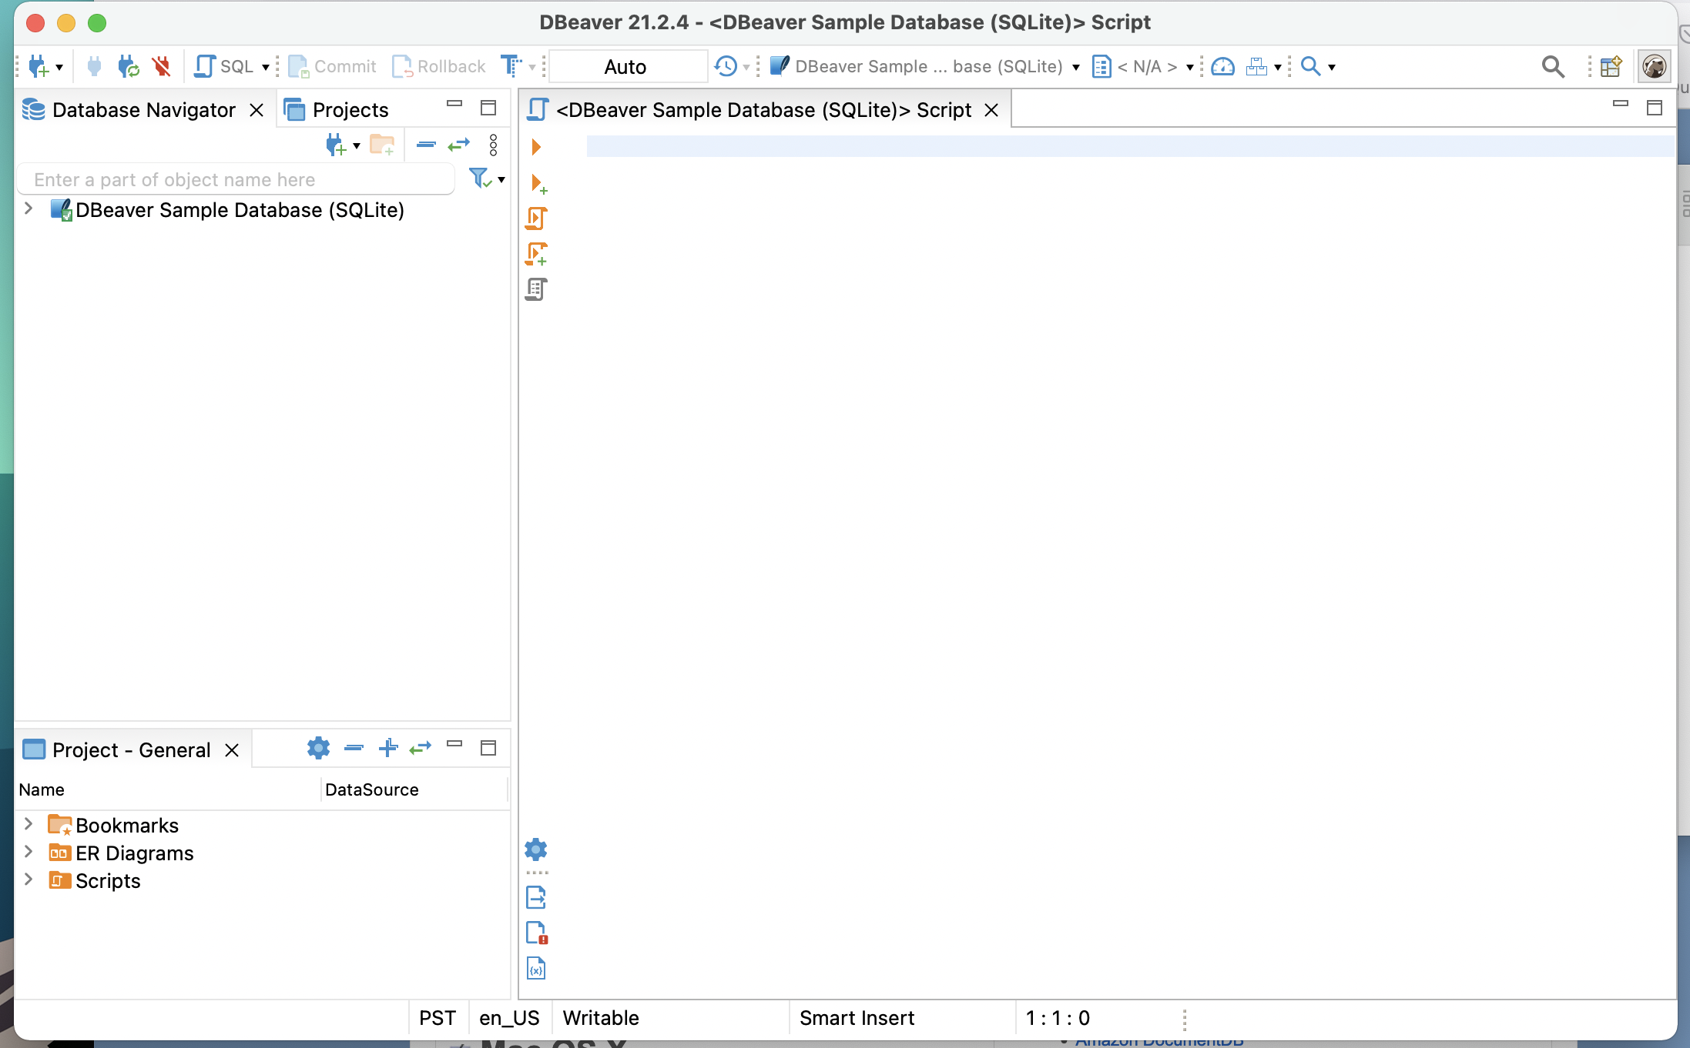
Steps to download (cont.)
Click at the top where it says SQL and it has a small little design of a fancy paper looking icon, it should open a script editor. This is what your full interface should look like before starting the workshop.

Slide 14
Workshop ready
Make sure to bring:
Computer
Dbeaver downloaded and setup

